Slide 1
Cyberbullying Detection using Explainable AI with Pyspark
Group 6
22273011 Salman Sadat Nur
22173003 S. M. Niaz Morshed
19101372 Ibrahim Lokman

Slide 2
Contents:
Introduction 3
Related Work 4
Pyspark Environment 5
Methodology 6
Result Analysis 10
Conclusion and Future Work 13

Slide 3
Introduction
Cyberbullying and Cyberharassment
Explainable AI or XAI
Local Model Agnostic Explanation (LIME)
Presenter: Ibrahim Lokman | ID: 19101372

Slide 4
Related Works
Text-Matching Method
Intelligent Tag-based Approaches
Genetic Algorithm
Neural Network
Social media based analysis and data mining
Keyword matching
Opinion mining
Social network analysis
Deep Neural Network
Natural language processing
Presenter: Salman Sadat Nur | ID: 22273011

Slide 5
Spark Environment
Supports many programming languages
Works well in memory
Spark Ecosystem : Spark Core Component, Spark SQL, Spark Streaming, Spark MLlib, Spark Graphs, Spark R
Spark MLlib
Features:
Rapid Processing
Highly Dynamic
Reusability
Presenter: Salman Sadat Nur | ID: 22273011

Slide 6
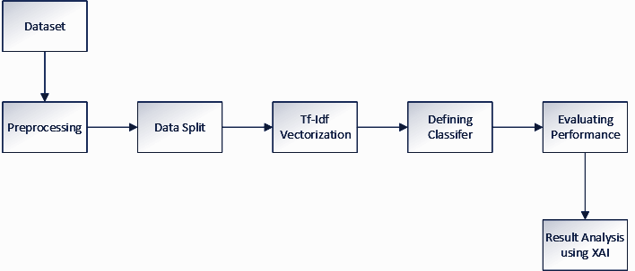
Methodology
Presenter: S. M. Niaz Morshed | 22173003

Slide 7
Methodology
Dataset
We have collected our dataset from a Kaggle competition founded by Google and jigsaw
Includes Tweets from Twitter.
CSV(comma separated values) formatted dataset
Contains 47680 tweets with several categories
Presenter: S. M. Niaz Morshed | 22173003

Slide 8
Methodology
Preprocessing
Tweets are mostly non-standard english.
We have defined a function (clean_text) to clean the dataset.
A new column Cyberbullying/Not-cyberbullying to define if the comment falls under any of the categories.
We have defined another function(remove_stop_words)to remove specific words.
Presenter: S. M. Niaz Morshed | 22173003

Slide 9
Methodology
TF-IDF vetorization
NLP tasks require effective embedding
The unsupervised weighting scheme TF-IDF to create word embeddings consisting sparse matrix.
We utilized TfidfVectorizer from sklearn library's 'feature_extraction.text' package
We used logistic regression classifier to make the prediction model.
Presenter: S. M. Niaz Morshed | 22173003

Slide 10
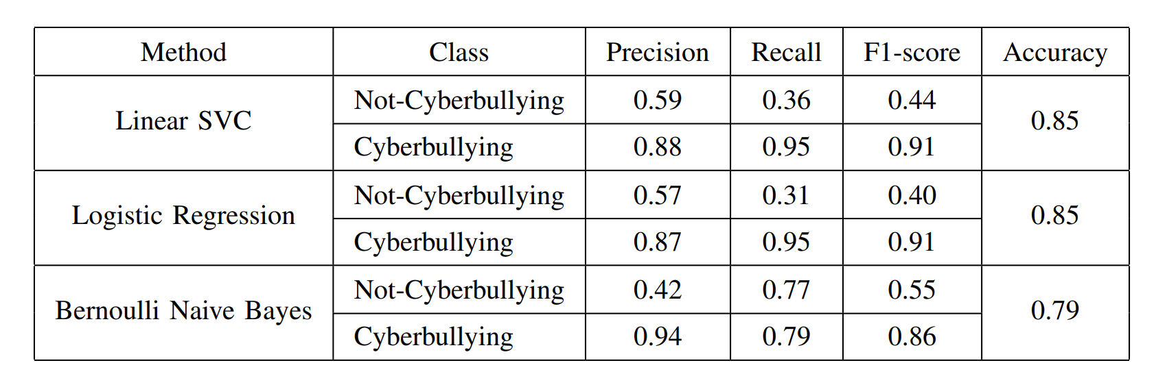
Result Analysis: Model Comparison
Presenter: S. M. Niaz Morshed | 22173003

Slide 11
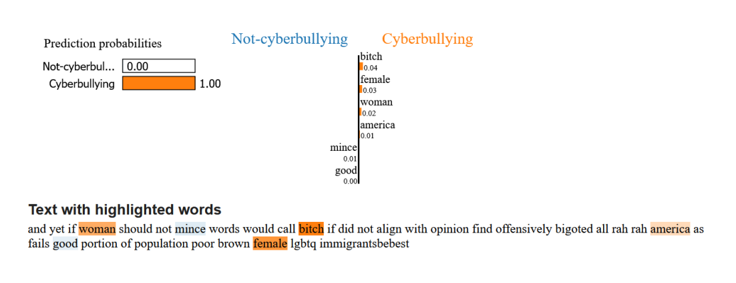
Result Analysis with XAI
Presenter: S. M. Niaz Morshed | 22173003

Slide 12
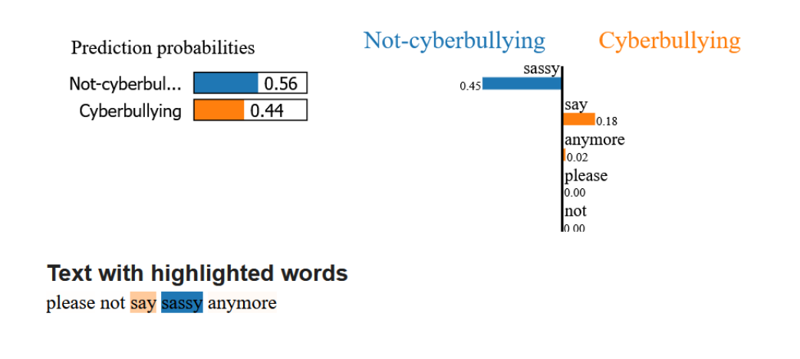
Result Analysis with XAI
Presenter: S. M. Niaz Morshed | 22173003

Slide 13
Conclusion and Future Work
Integrate syntactic features.
Integrate sentiment analysis in the future.
Detects misuse of emoji.
Presenter: Ibrahim Lokman | ID: 19101372

Slide 14
Thankyou

